Slide 1

Yonghao Li
Team members: Jiadeng, Weixi

Slide 2
Overall
1. MaxPool2d (kernel_size=2, stride=1)
2. AvgPool2d (kernel_size=2, stride=1, count_include_pad=True)
3. roi_pool (input: Tensor, boxes: Tensor, output_size, spatial_scale: float = 1.0)
4-5. Conv2d (in_channels=3, out_channels=6, kernel_size, stride)
4 No dilation, 1
5 With dilation, 2

Slide 3
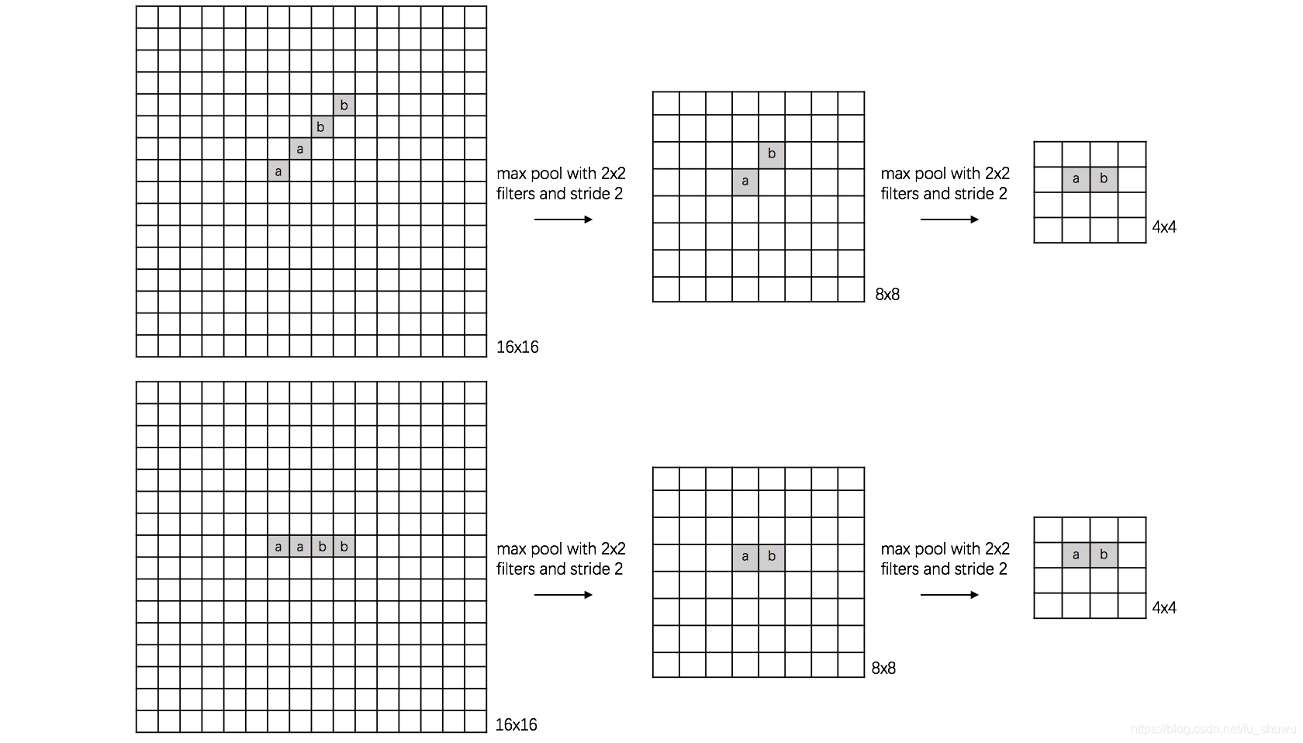
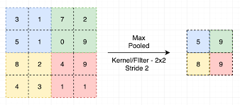
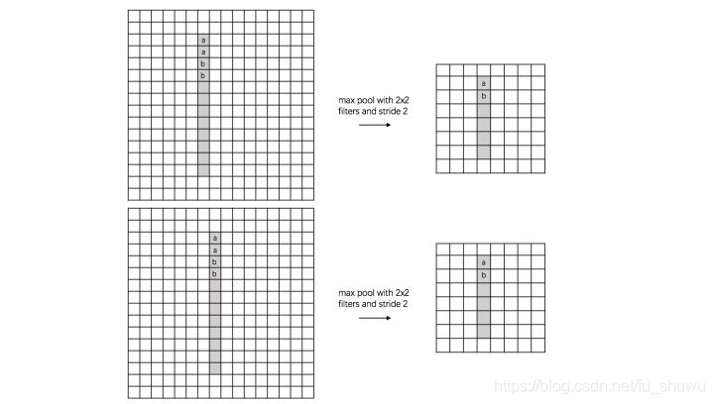
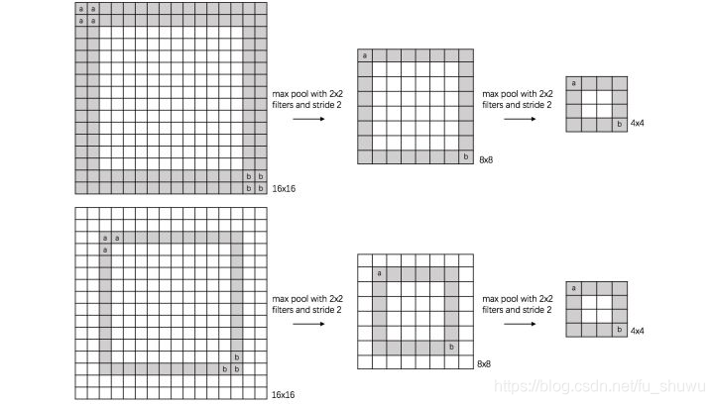
1. Maxpolling functions
principle
(2) rotation invariance：
(1) translation invariance：
(3) scale invariance：

Slide 4
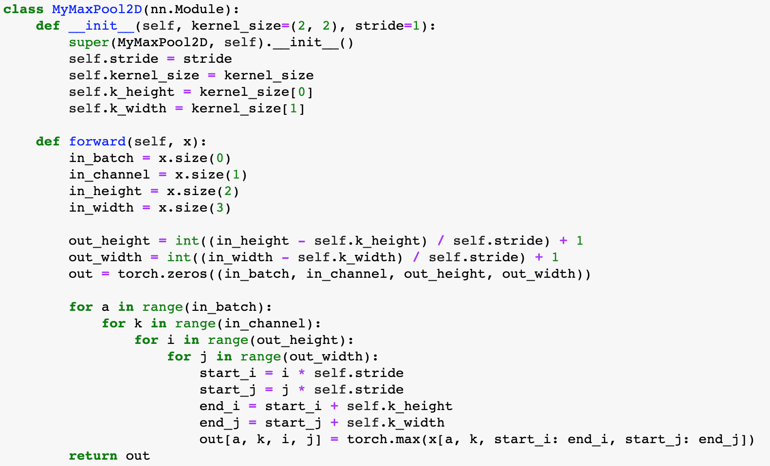
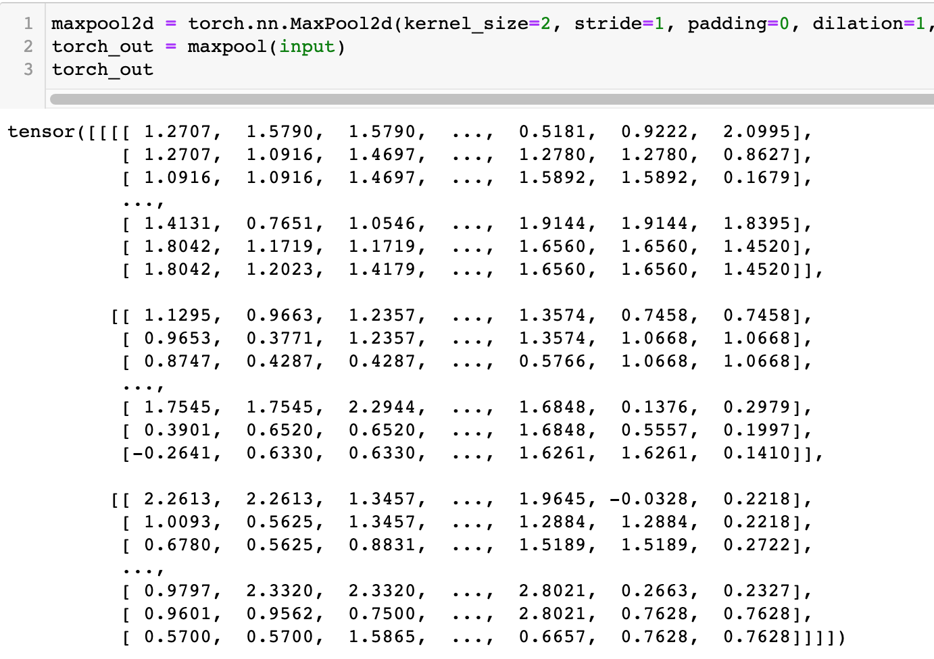
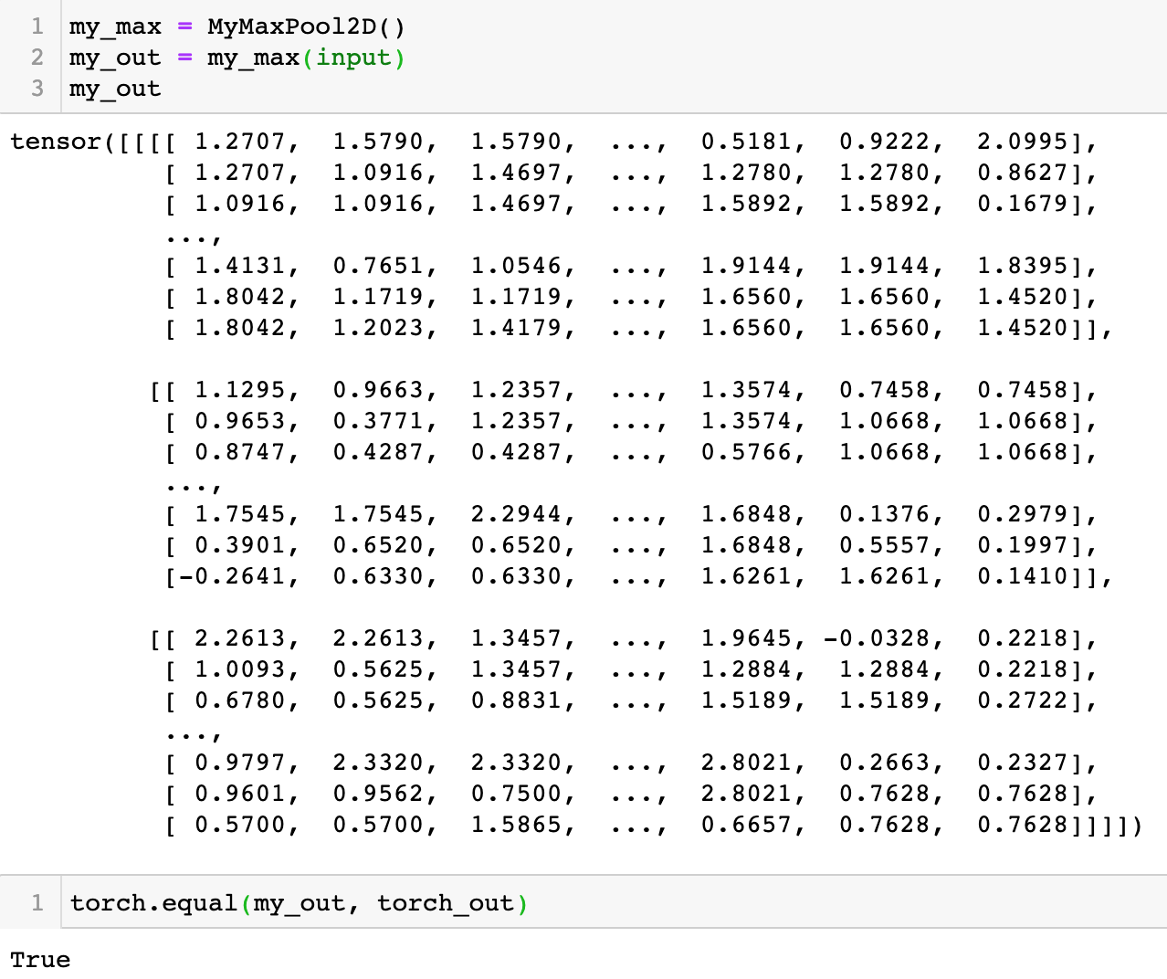
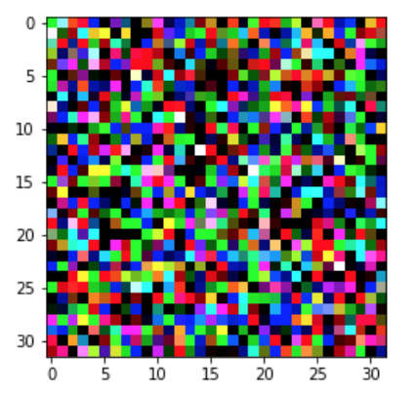
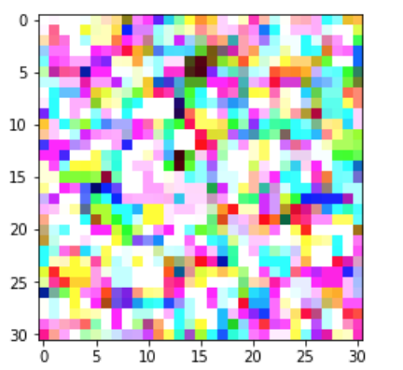
Coding
Check the result

Slide 5
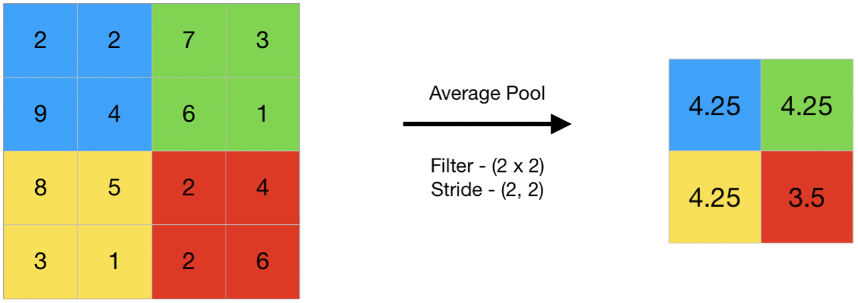
2. averagepolling functions
The main function of pooling is to remove redundant information on the one hand, and to retain the feature information of the feature map on the one hand, while reducing the dimensions.
According to related theories, the error of feature extraction mainly comes from two aspects:
(1) Increased variance of estimated value caused by limited neighborhood size;
(2) The parameter error of the convolutional layer causes the deviation of the estimated mean value.
average-pooling can reduce the first type of error and retain more background information of the image, and max-pooling can reduce the second type of error and retain more texture information.
principle
It also has:
(1) translation invariance：
(2) rotation invariance：
(3) scale invariance：
Notes:
Generally speaking, the effect of max-pooling is better, and max-pooling is more like a feature selection, which selects features with better classification recognition and provides non-linearity. On the one hand, it can suppress noise, and on the other hand, it can improve the significance of the feature map in the region (the maximum value selected).

Slide 6

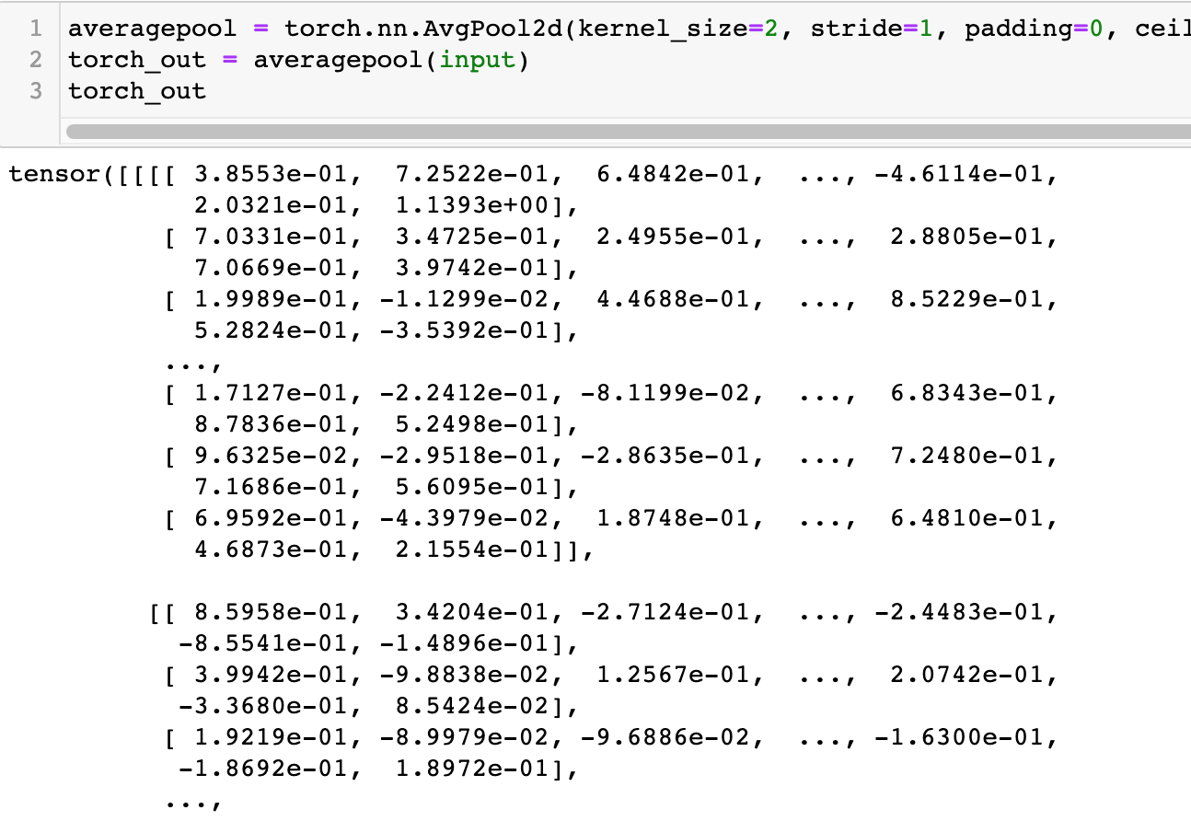
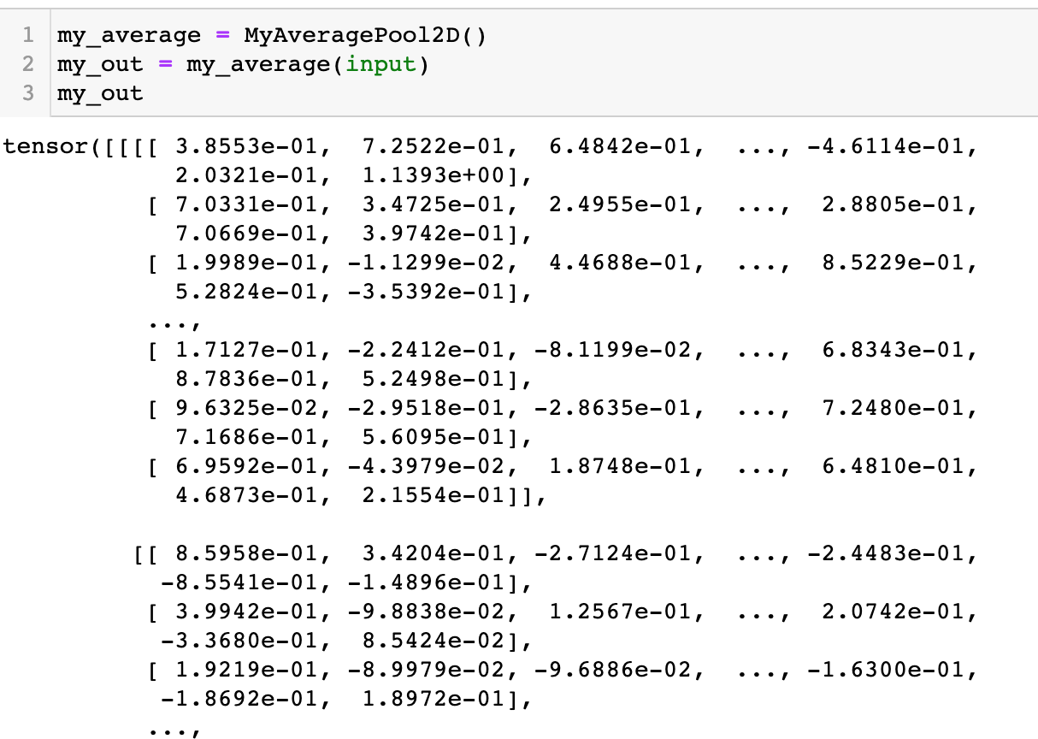
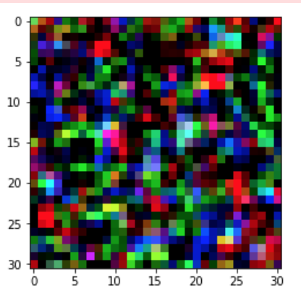
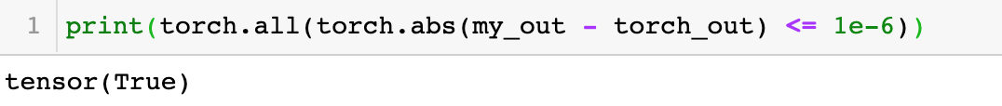
Coding
Check the result

Slide 7
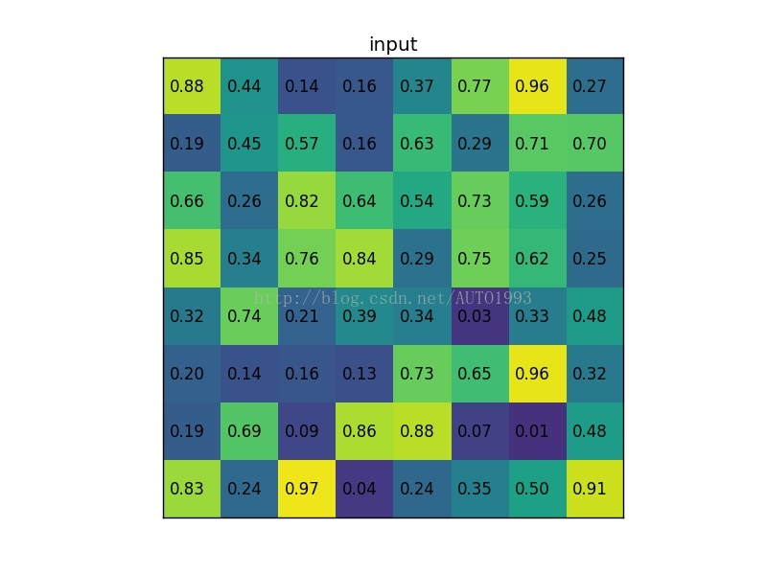

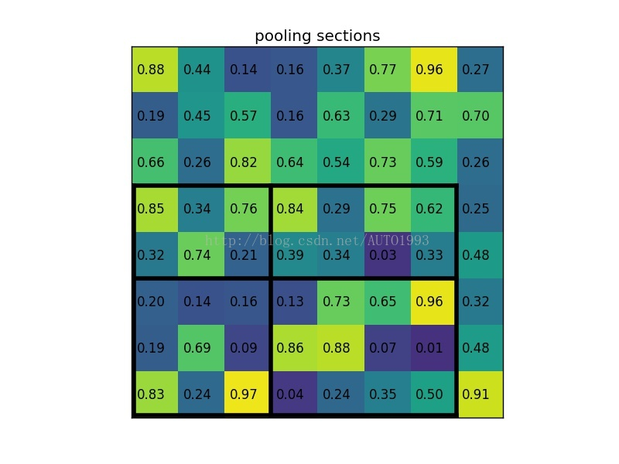
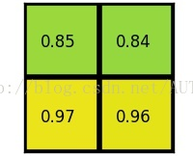
3. ROI pooling
(2)Position after egion proposal projection (upper left corner, lower right corner coordinates): (0, 3), (7, 8)
(1) The input feature map of fixed size
(3) Divide it into (2*2) sections
(4) Do max pooling for each section
Notes:
Generally speaking, the effect of max-pooling is better, and max-pooling is more like a feature selection, which selects features with better classification recognition and provides non-linearity. On the one hand, it can suppress noise, and on the other hand, it can improve the significance of the feature map in the region (the maximum value selected).

Slide 8
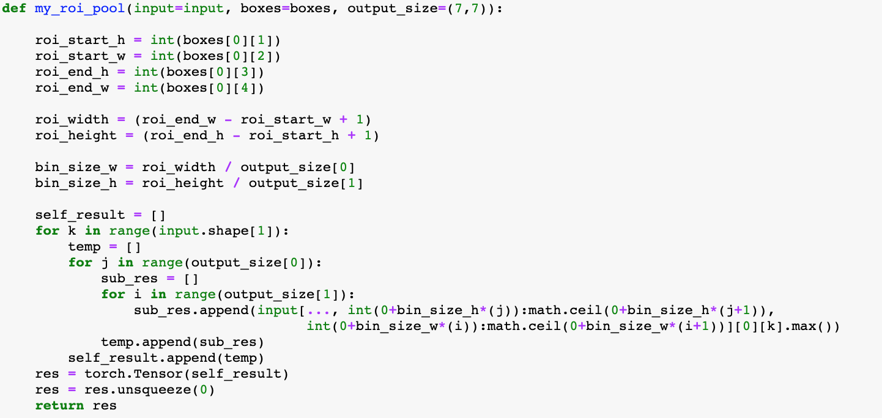
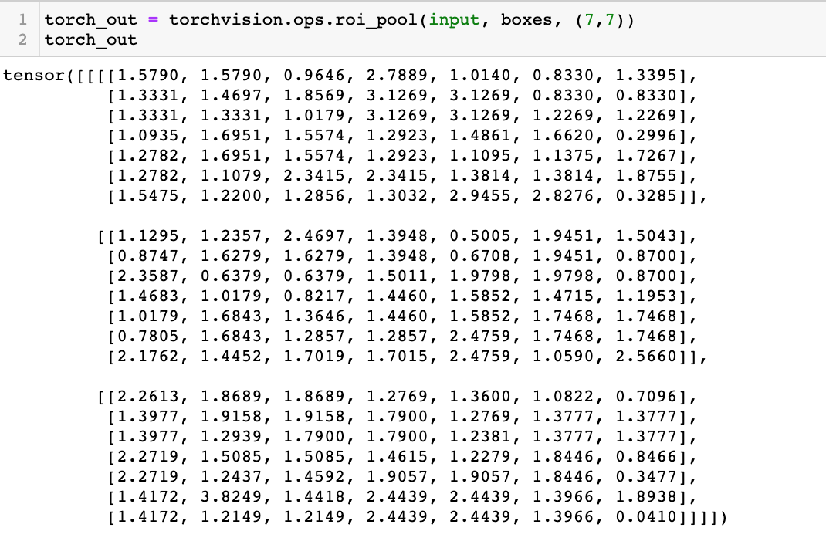
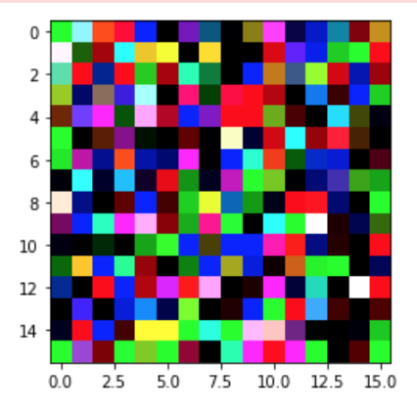
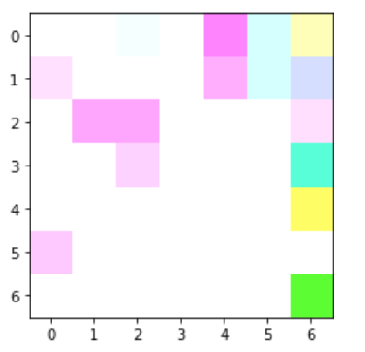
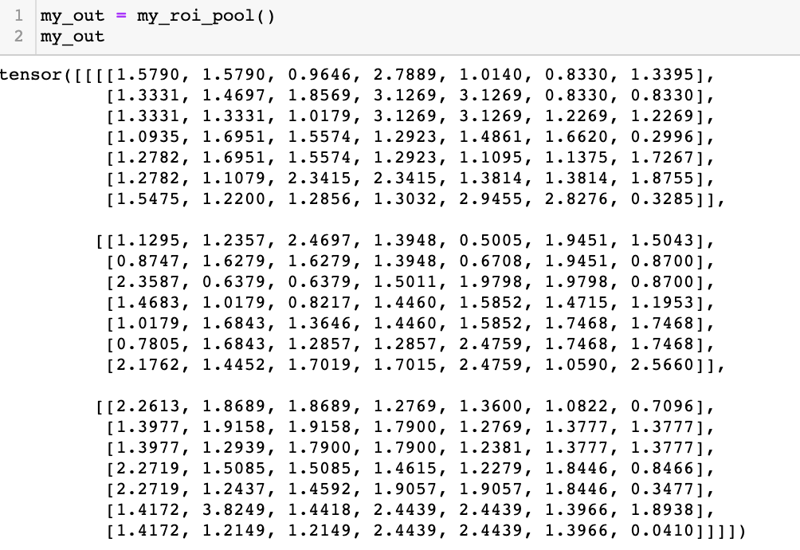
Coding
Check the result

Slide 9
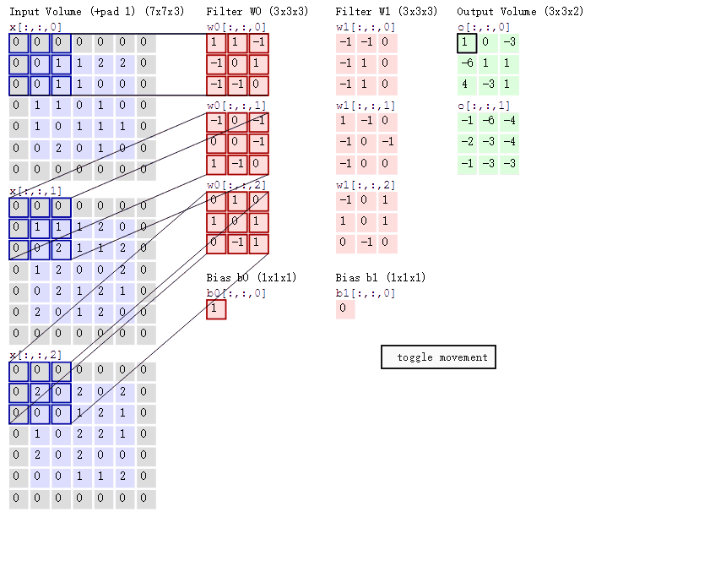

4-5. Conv2d functions
Kernel shape (6, 3, 3, 3)
Input shape (1, 3, 32, 32)
Output shape (1, 6, 32, 32)
Dilation = 2
principle
Notes:
Generally speaking, the effect of max-pooling is better, and max-pooling is more like a feature selection, which selects features with better classification recognition and provides non-linearity. On the one hand, it can suppress noise, and on the other hand, it can improve the significance of the feature map in the region (the maximum value selected).

Slide 10
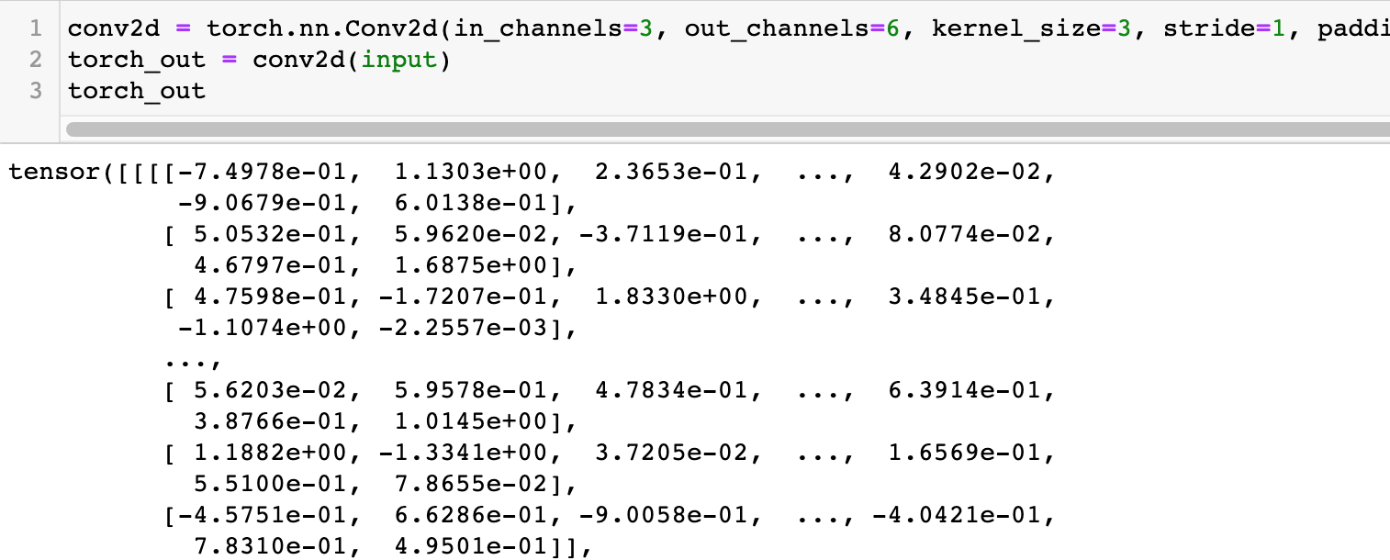
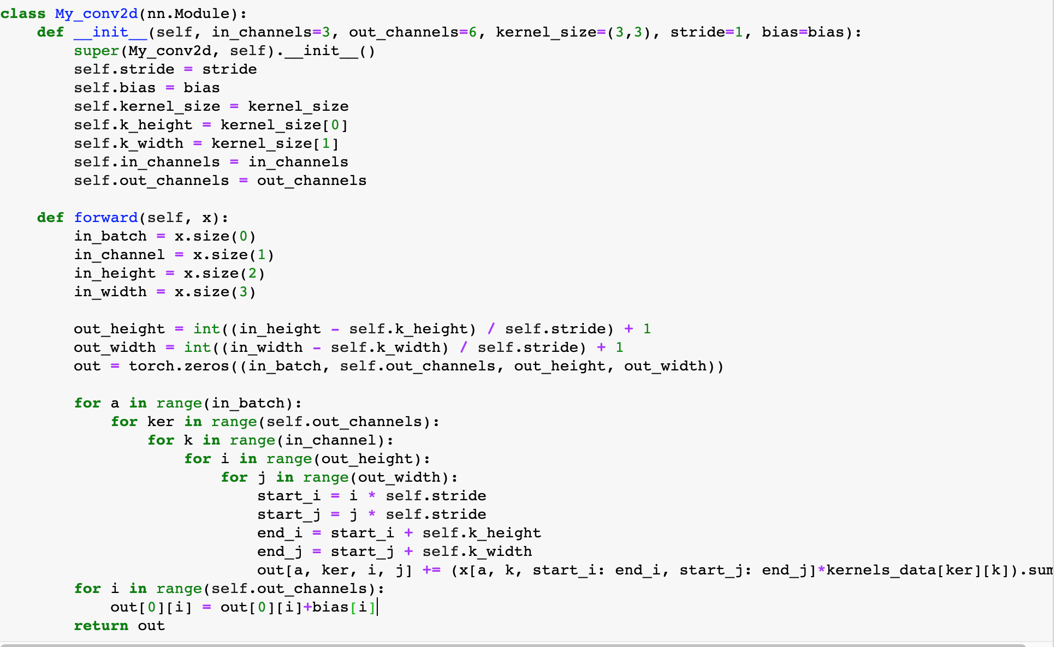
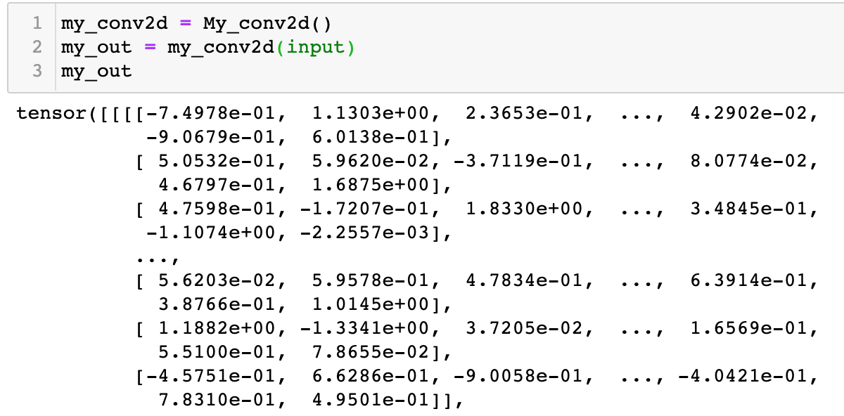
Coding dilation=1
Check the result

Slide 11
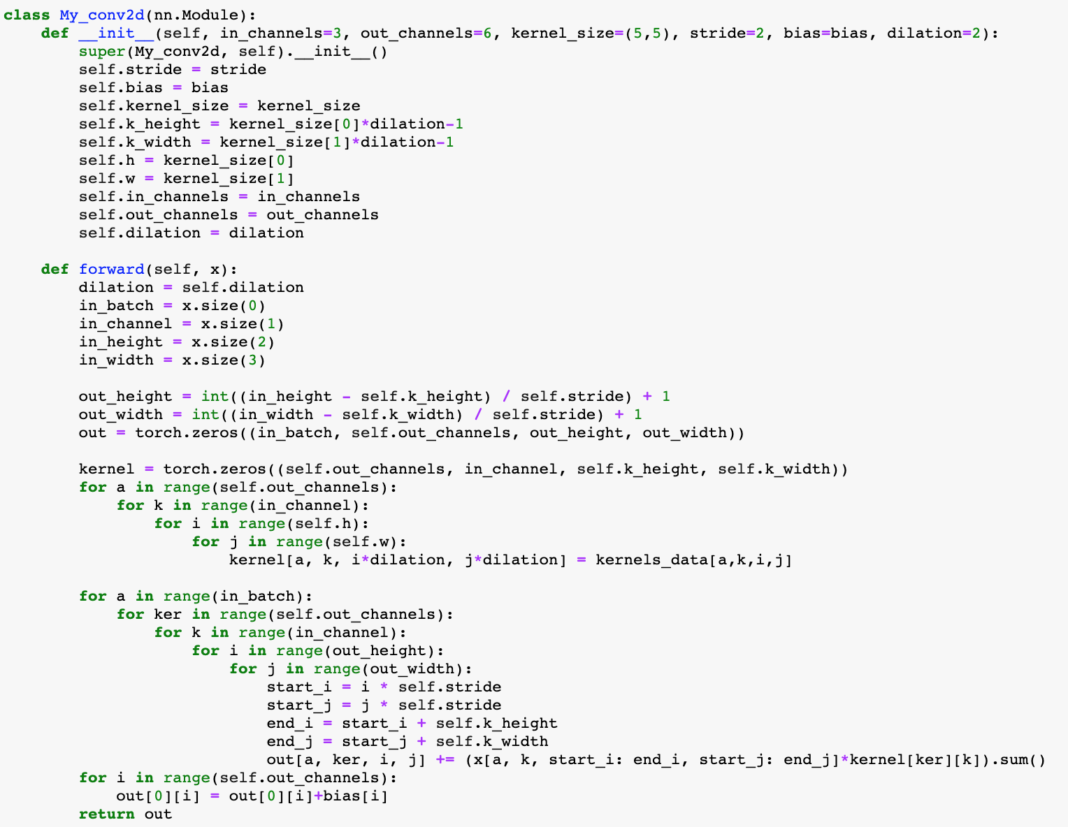
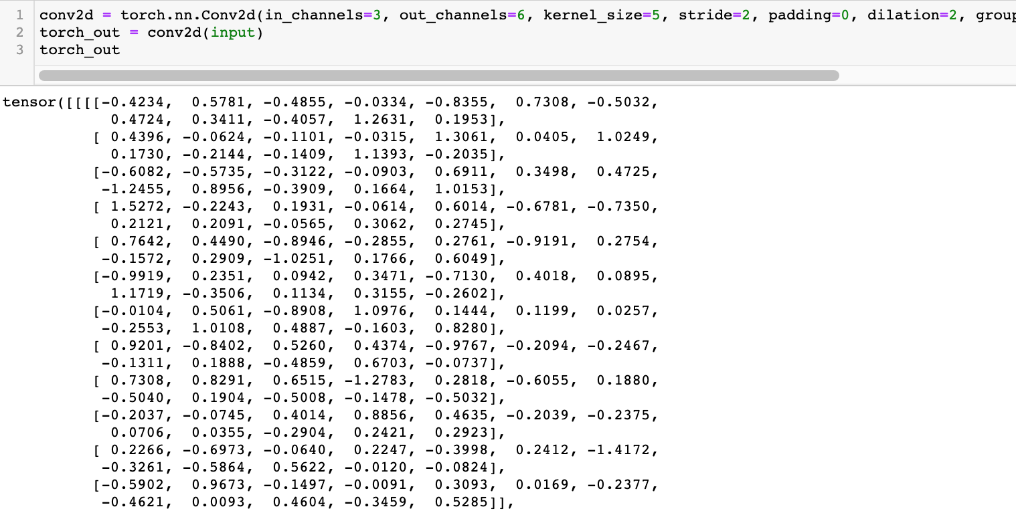
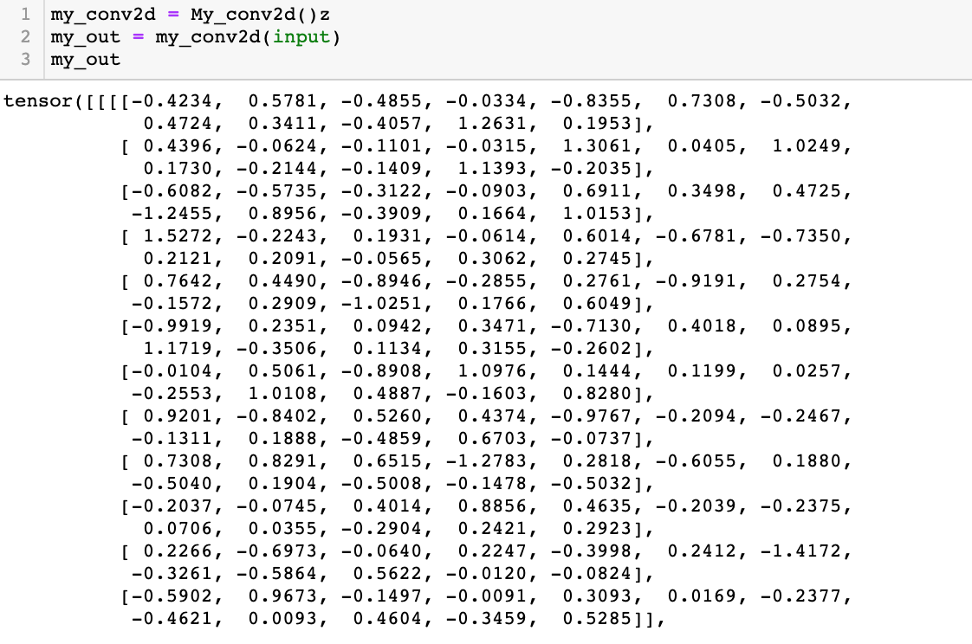
Check the result
Coding dilation=2

Slide 12
Thank you

Slide 13
Q | A

